Slide 1
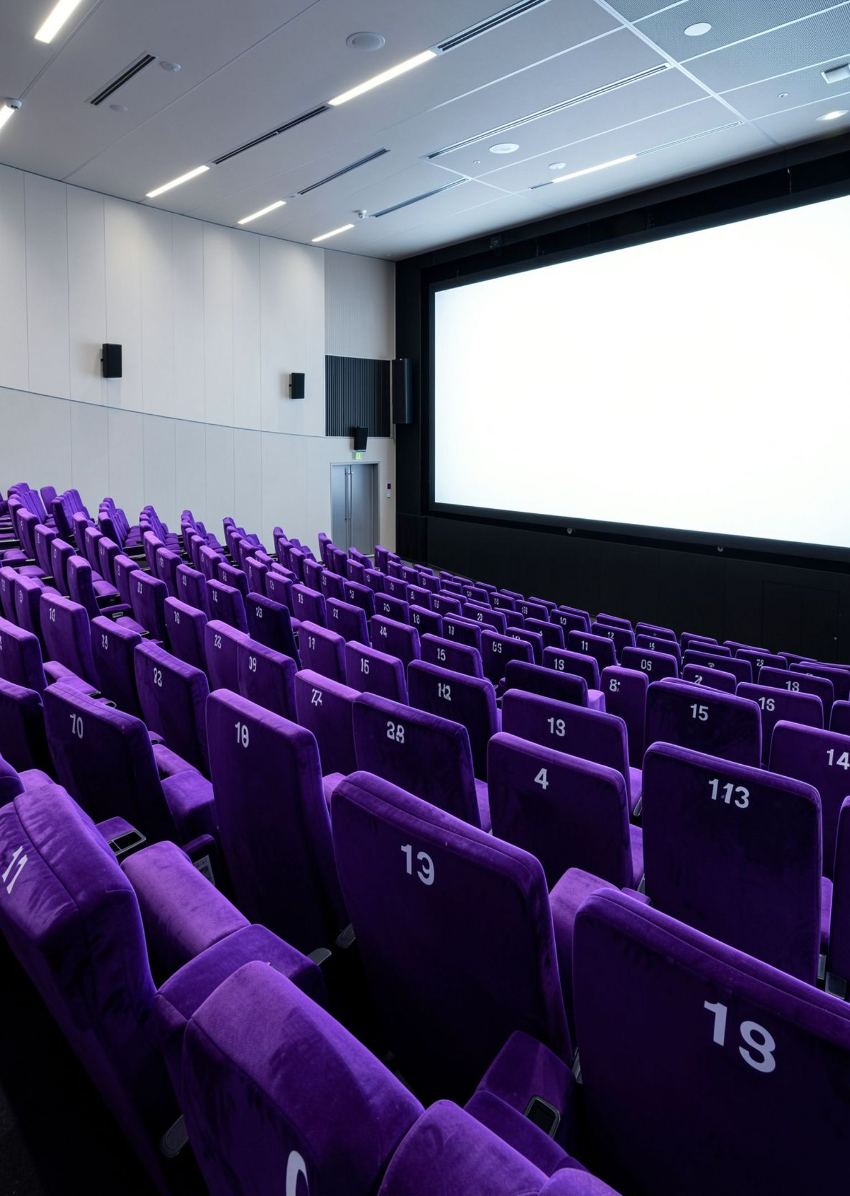
B.TECH FIRST-SEMESTER PROJECT · JAVA PROGRAMMING
CINEMA SEAT BOOKING SYSTEM
C. Akshitha Reddy – 2620030477
C. Naga Vaishnavi – 2620030490
OBJECT-ORIENTED PROGRAMMING IN JAVA ·
Notes:
Good morning. Today we present our first-semester B.Tech project: the Cinema Seat Booking System developed in Java.

Slide 2
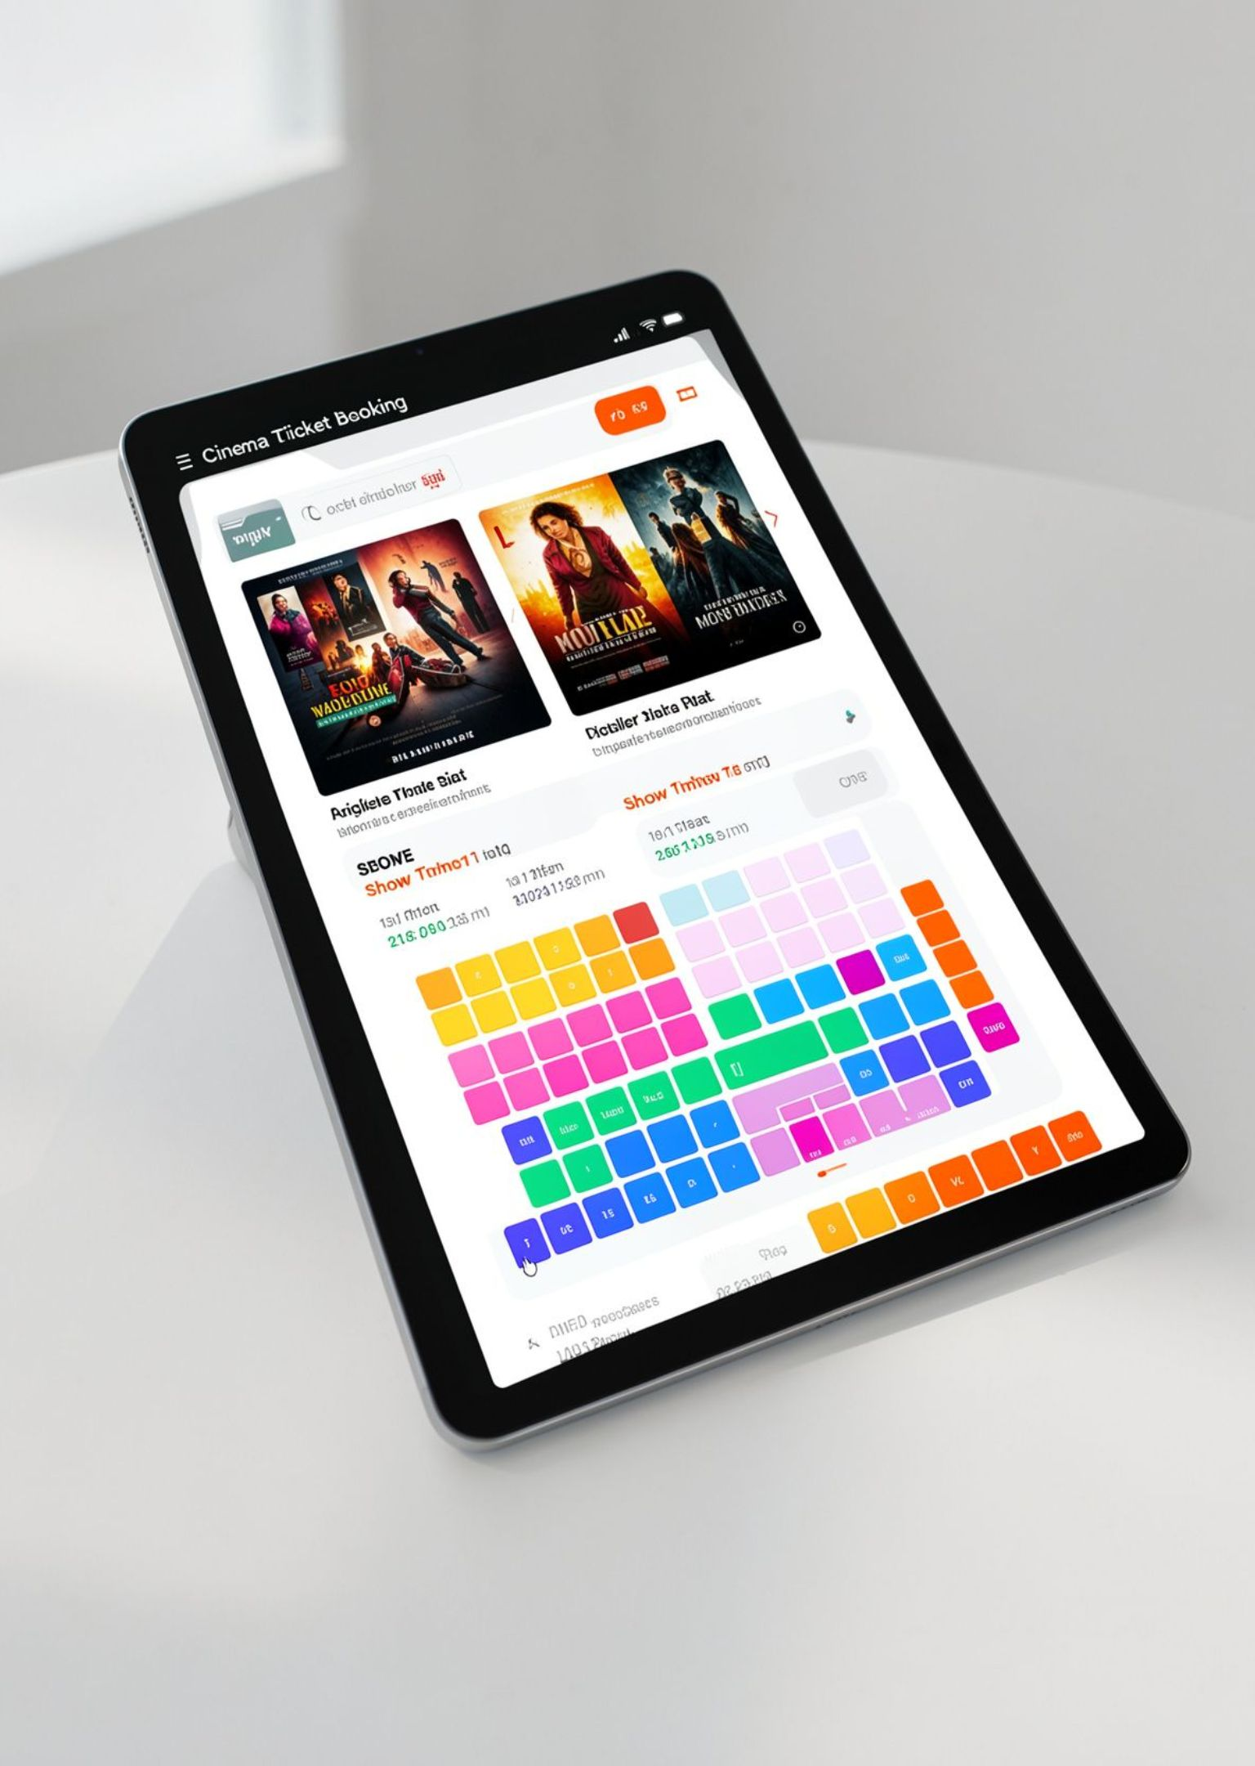
PROJECT OVERVIEW
Introduction
“Our project is a Cinema Seat Booking System developed using Java. It is used in movie theatres and online ticket booking systems to help users reserve seats easily. It allows users to choose a movie, select a show timing, and book available seats. This makes the booking process faster, more accurate, and user-friendly.”
PROJECT SCOPE · JAVA CONSOLE ARCHITECTURE
02
Notes:
This slide introduces our system purpose: helping users select movies, choose show timings, and book seats accurately using standard Java features.

Slide 3

Module 1: Concepts Used in Our Project
Variables & Data Types
Constants & Literals
Store movie names, seat numbers, timings, and booking details.
Represent fixed values such as seat limits and show timings.
Operators
Type Casting
Perform calculations and comparisons related to booking.
Convert input values when required for calculations.
Scanner / Console Input
Formatted Printing
Take the user's movie, timing, and seat choices.
Display movie details, seat information, and booking confirmation clearly.
03
Notes:
Module 1 covers elementary Java programming foundations: variables, constants, operators, casting, Scanner console input, and formatted printing.

Slide 4
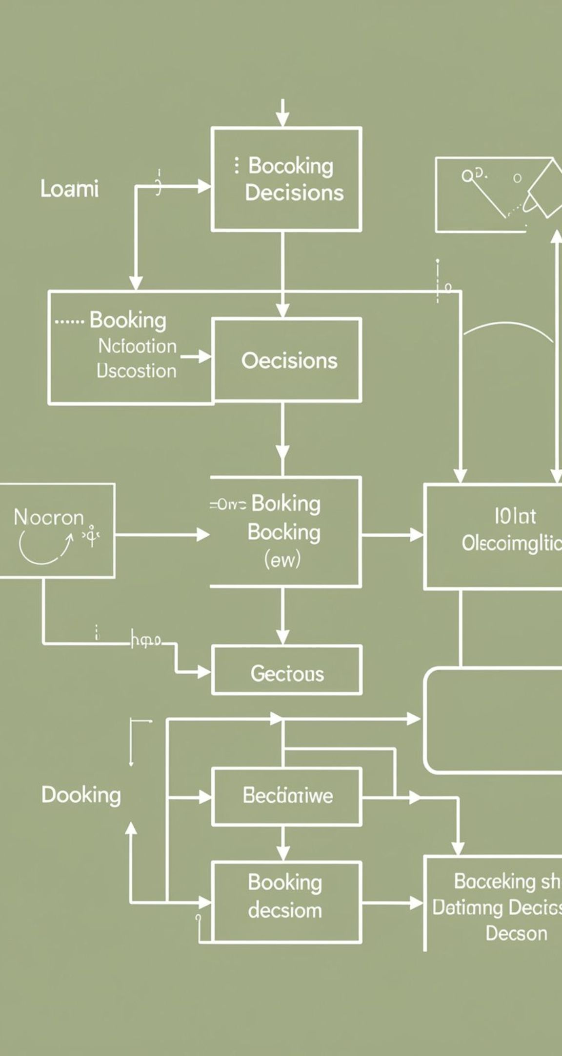
CONTROL FLOW & LOGIC
Module 2: Concepts Used in Our Project
if-else
if-else-if ladder
Check whether the selected seat is available or already booked.
Handle different movie, timing, or booking choices.
while Loop
Continue the booking process until the user finishes.
04
Notes:
Module 2 implements decision structures and iterative loops that govern seat validation, menu selection, and repetitive user interactions.

Slide 5

MODULARITY & DATA STRUCTURES
Module 3: Concepts Used in Our Project
Arrays
Store and manage seat information.
Searching
Find the selected seat or check its availability.
Counting
Keep track of the number of booked seats.
05
Notes:
Module 3 highlights functions and linear arrays: modular decomposition through methods, array storage for the cinema floor, and algorithms for searching and counting.

Slide 6

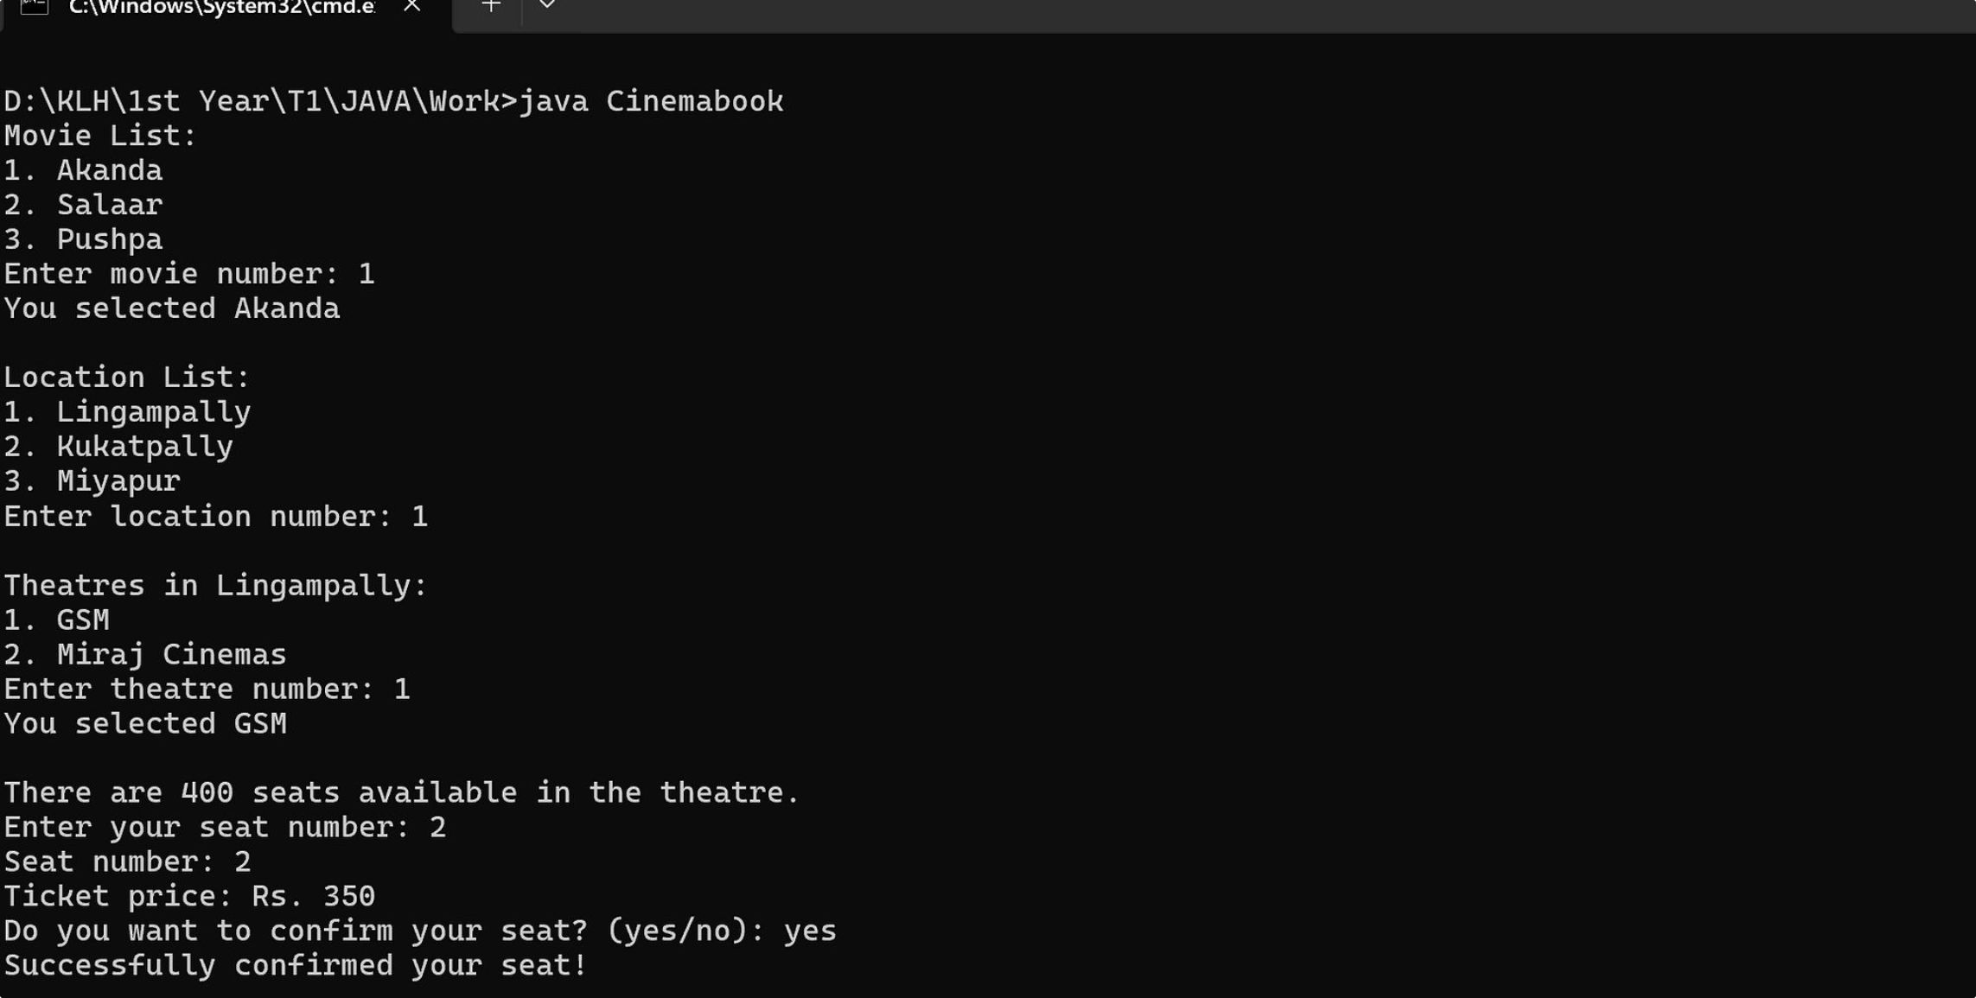
PROJECT DEMONSTRATION
Output
06
Notes:
This slide provides a clean, dedicated frame for the live demonstration and console output of the Cinema Seat Booking System.

Slide 7
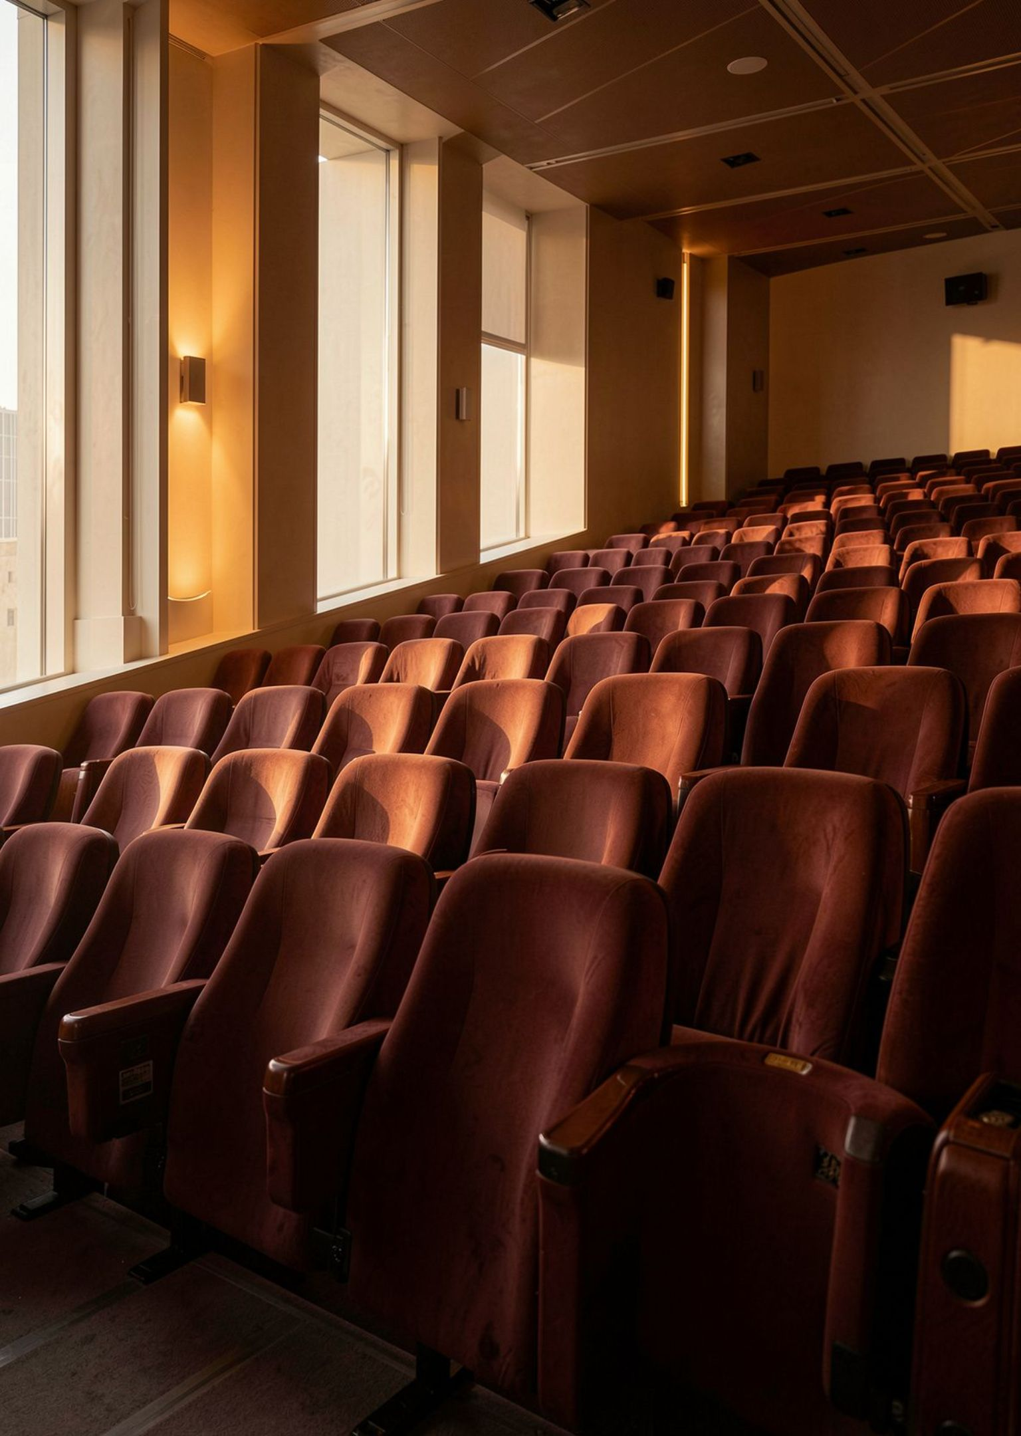
PROJECT PRESENTATION CONCLUDED
THANK YOU
PRESENTED BY
C. Akshitha Reddy – 2620030477
C. Naga Vaishnavi – 2620030490
CINEMA SEAT BOOKING SYSTEM · JAVA CONSOLE APPLICATION
Notes:
Thank you for your time and attention. We welcome any questions regarding the design, logic, and implementation of our project.

